Slide 1
iNethra

Slide 2
Problem Statement
LACK OF
1
Awareness of eye diseases in Rural People
2
Resources for DIAGNOSIS
3
Expertise Doctors

Slide 3
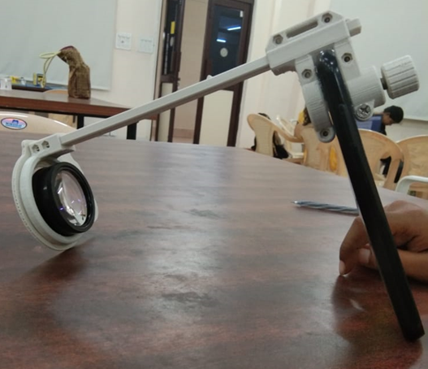
Solution
A smart phone attachable device which
captures retinal images clearly and analyzes
with an app (iNethra) to detect eye diseases
Features
Easily Scanable device
Sending the patient details along with their images to the expert doctors
By analyzing the images, doctor sends the feedback through iNethra
Referring the expertise doctor to the
patient based on the results

Slide 4
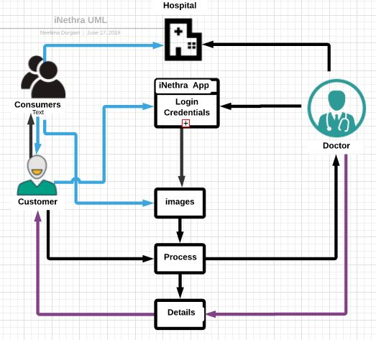
Mechanism

Slide 5
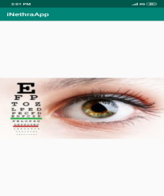
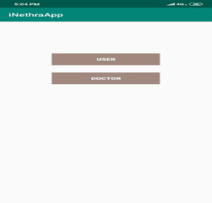
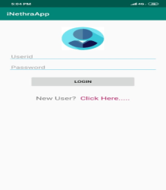
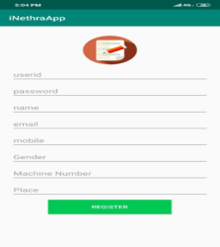
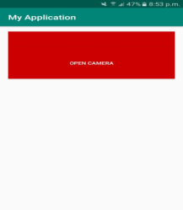
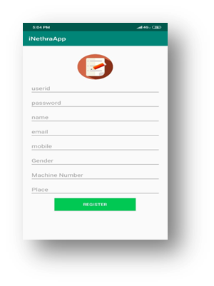
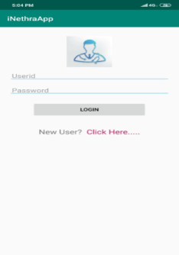
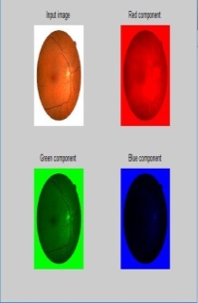
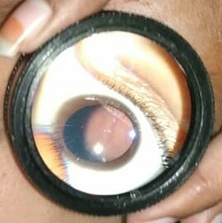
INETHRA APP

Slide 6



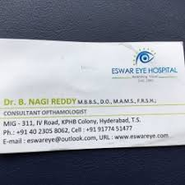

Market Research
Dr. Sai baba Goud ,
Padma Shri in Medicine
President of National Society of prevention of blindness
Dr. Madhavi Latha
MBBS,DNB-Ophthalmologist
Dr.Jagadeesh Ophthalmologist
Dr.Vijay Kiran
Ophthalmologist
Dr.Meenakshi
Ophthalmologist

Slide 7
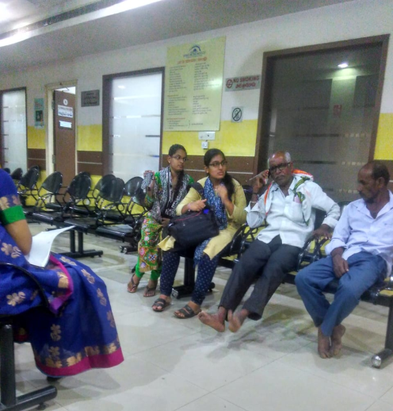
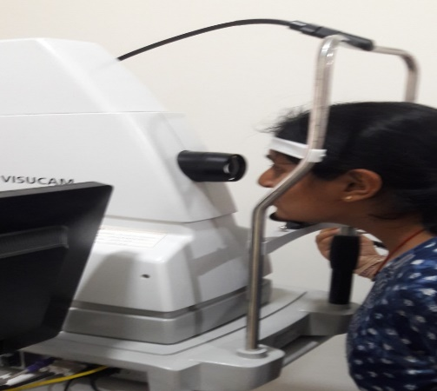
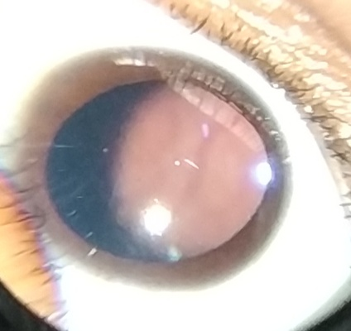
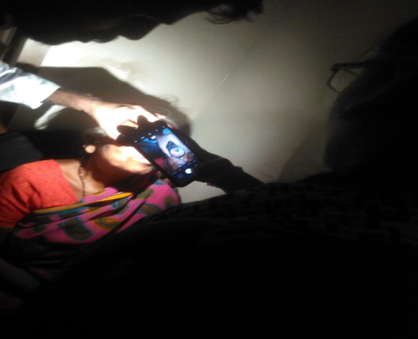
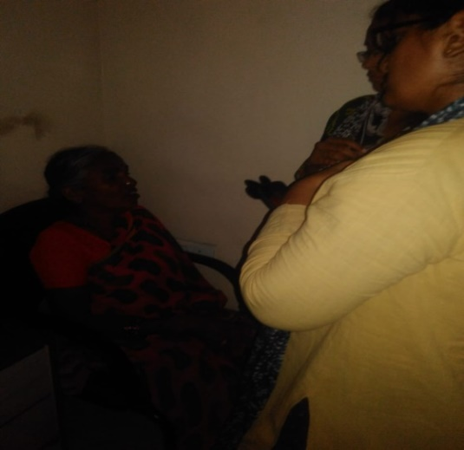
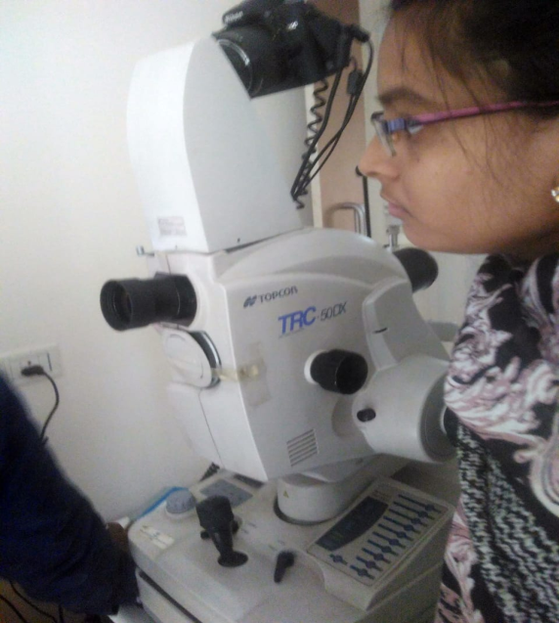
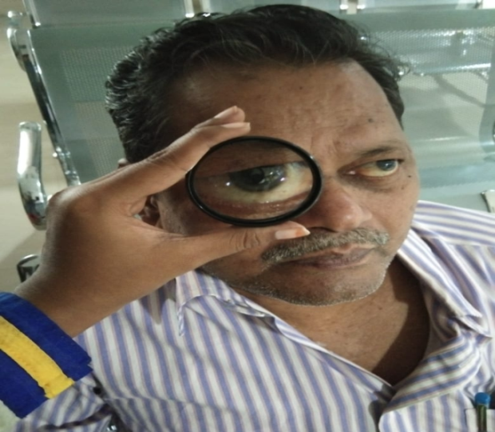
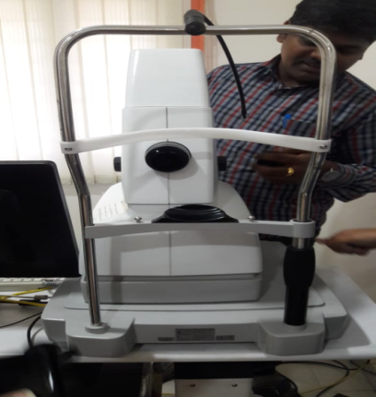

Slide 8
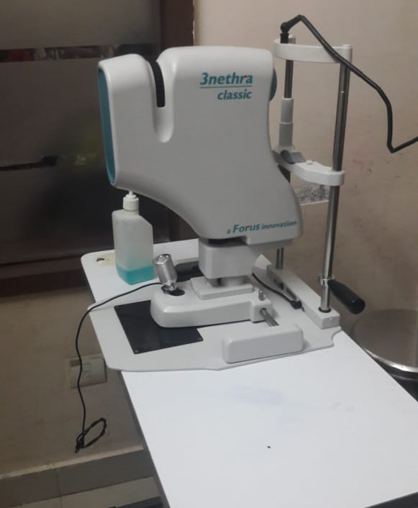
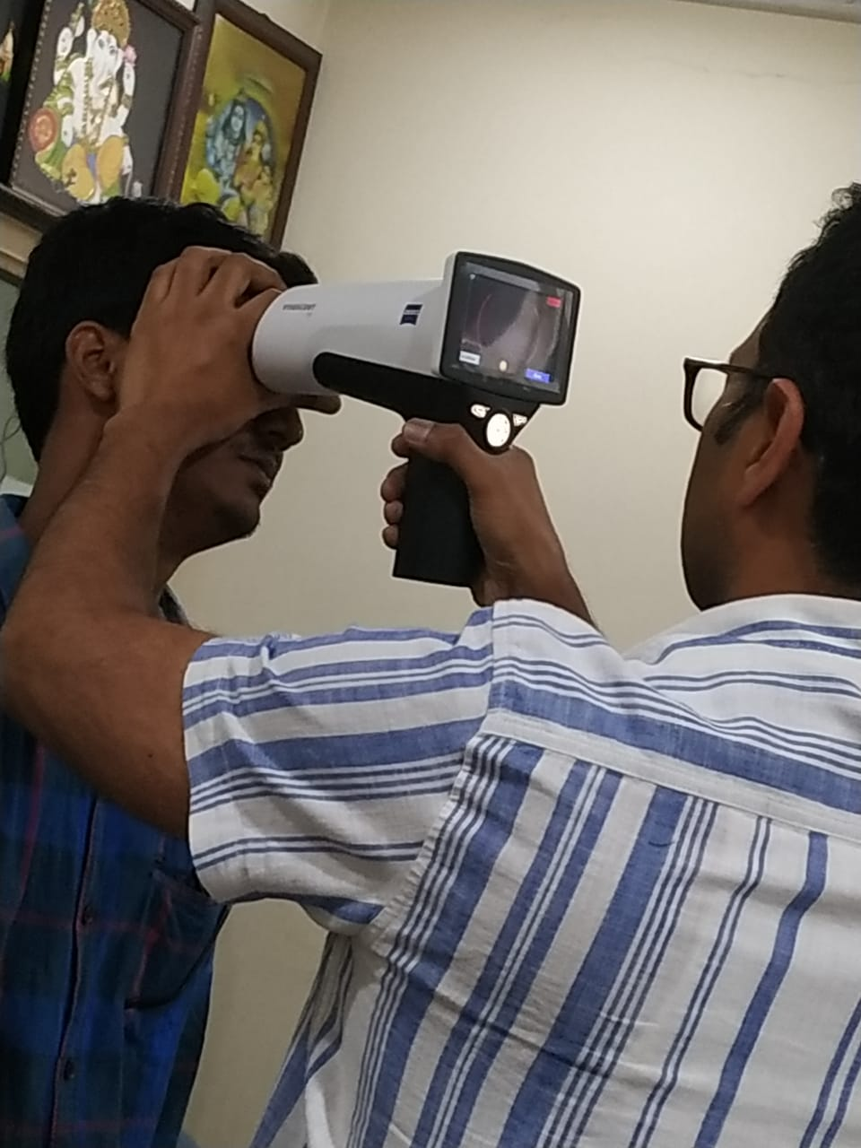
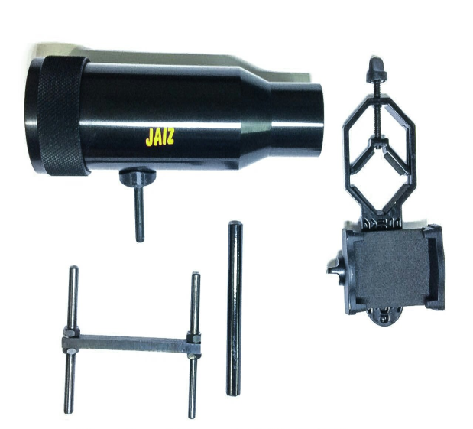
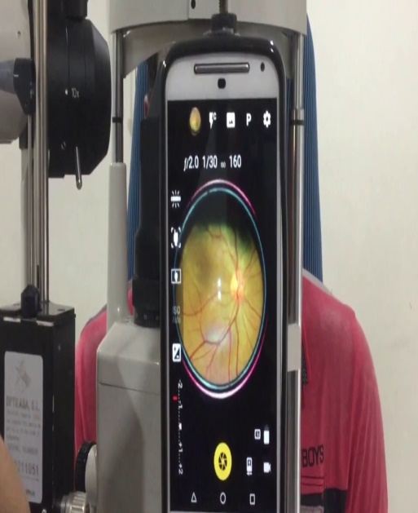
Competitors
Jaiz RetiCam
India
3Nethra
Zeiss
Name Here
Jaiz Reticam
20,000
5,50,000
3,00,000
Programmer

Slide 9
Competition Analysis
Features | Visuscout (Zeiss) 100 | 3nethra classic | Jaiz Reti cam | iNethra (Our Product)
Size | Medium | Large | Small | Small
Portability | portable | Portable | portable | portable
Presence of expertise | Not needed | Needed | Needed | Not needed
Cost | Highly expensive | Expensive | Reasonable | Reasonable
Transportation | difficult | difficult | Easy | Easy
Price | 3,00,000 | 5,50,000 | 20,000 | 15,000
Mydriatic | Non- mydratic | Non- mydratic | Mydratic | Mydratic
Availability areas | Rarely available | Rarely available | Easily available | Easily available
Power consumption | Requires High power | Requires high power | Moderate power | Moderate power
Computer Vision | No | No | No | Yes (underprocess)
Camera | Fundus | Fundus | iPhone, MOTO G2 | Any mobile camera

Slide 10
Disease Detection
Glaucoma
Diabetic Retinopathy
Hypertension
Retinal detachment
Age Related Macular Degeneration
Cancer

Slide 11


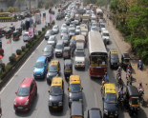
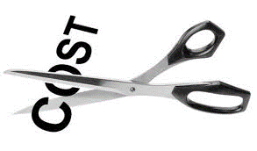

Value Proposition
Saves Time
Connects
Reduces Efforts
Reduces Cost
Wellness

Slide 12
COST
Raw Materials – 5,000 /-
Infrastructure – 3,000 /-
Research Expenses – 2,000 /-
Total cost – 10,000 /-
Selling Price - 15,000 /-

Slide 13
Marketing Strategy
Targeted Customers
02
Consumers
Public Health Care Centers(PHC’s)
Optical Eye Care Clinics
People in Rural Areas
01
Market Strategy
03
Channel
Directly to customers through demos
Social Media
Influencers
Customers
Doctors
04

Slide 14
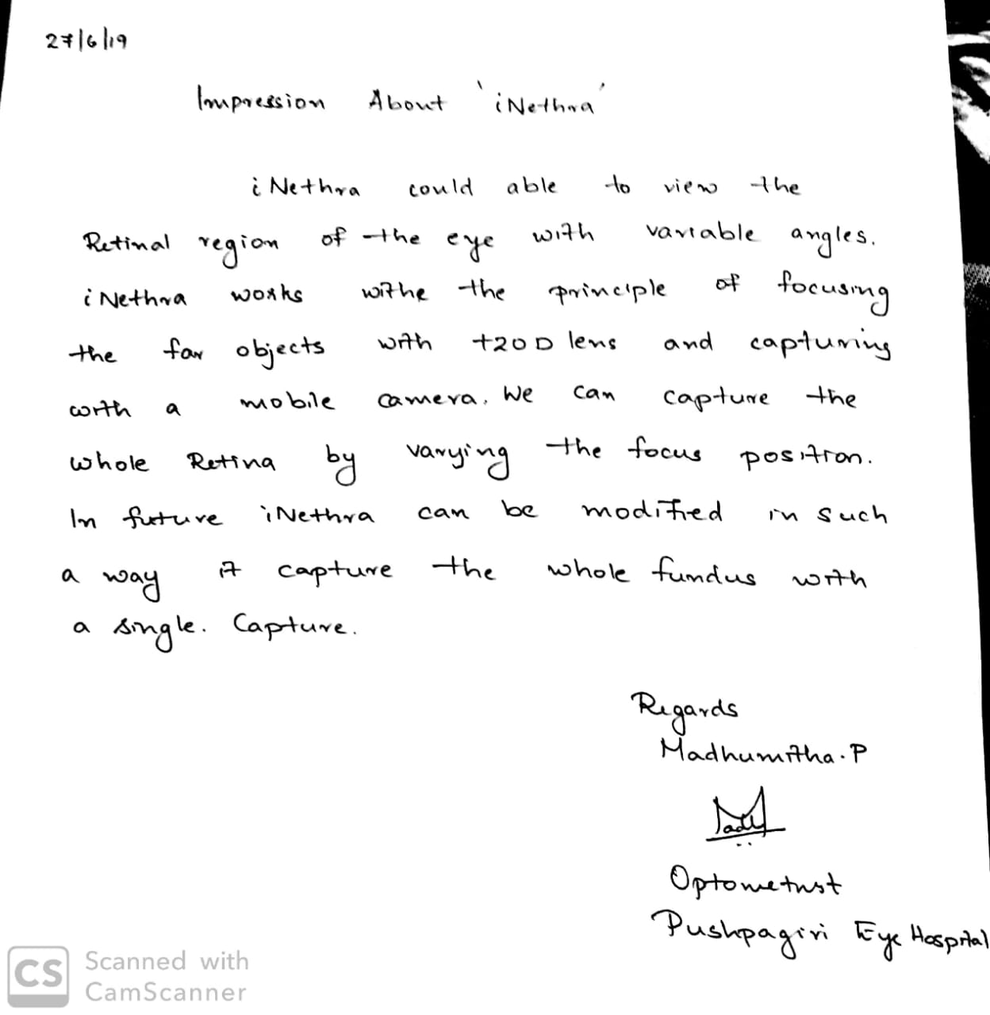
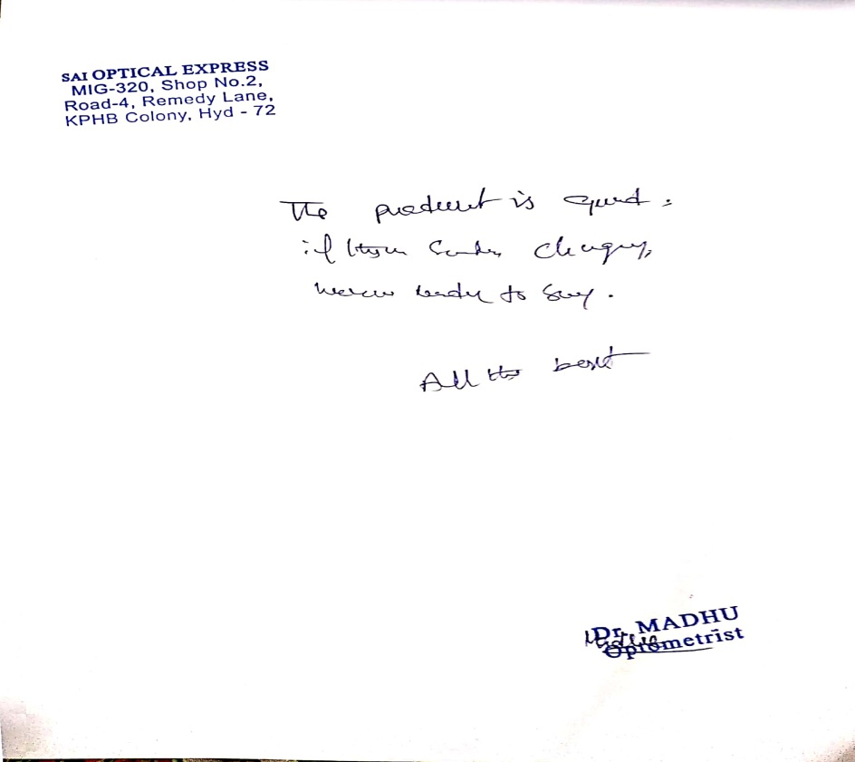
Testimonials
Doctor
Customer

Slide 15
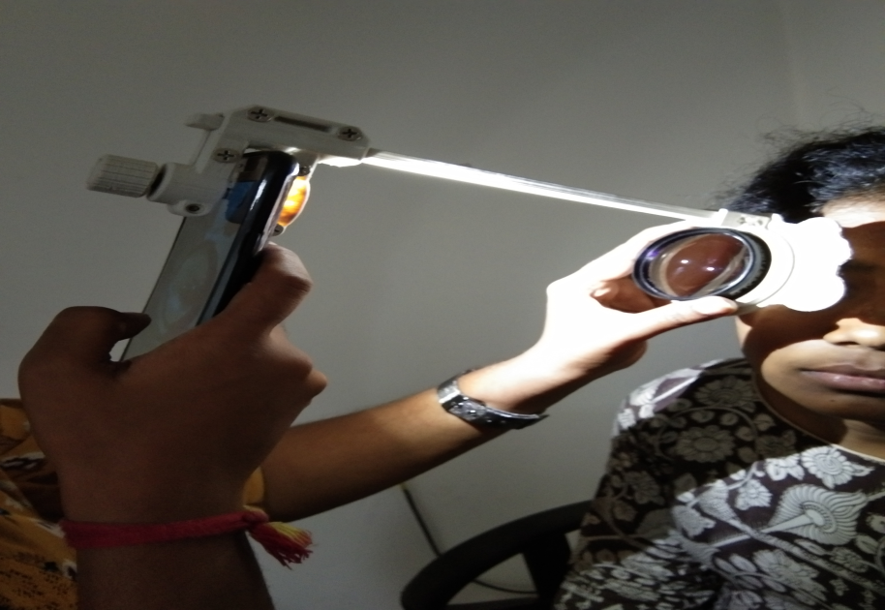
iNethra
Status:
Capturing retinal images
Sending the images to doctors through ‘iNethra’ app
Next Step :
Image Processing
Adding Google maps

Slide 16
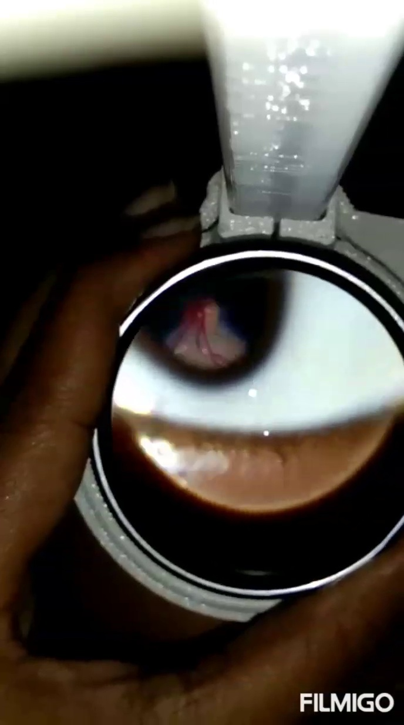
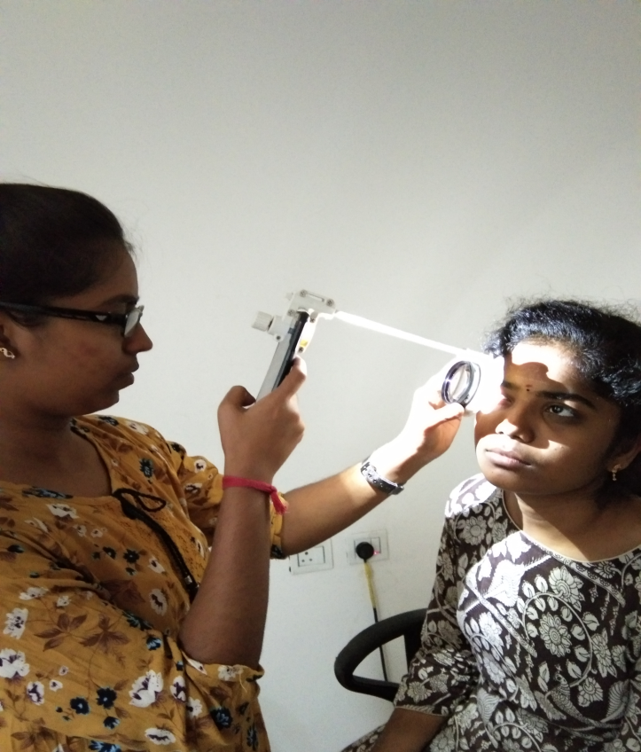
Working
https://youtu.be/X-3ACwn8meY..\Videos\Captures
https.docx

Slide 17
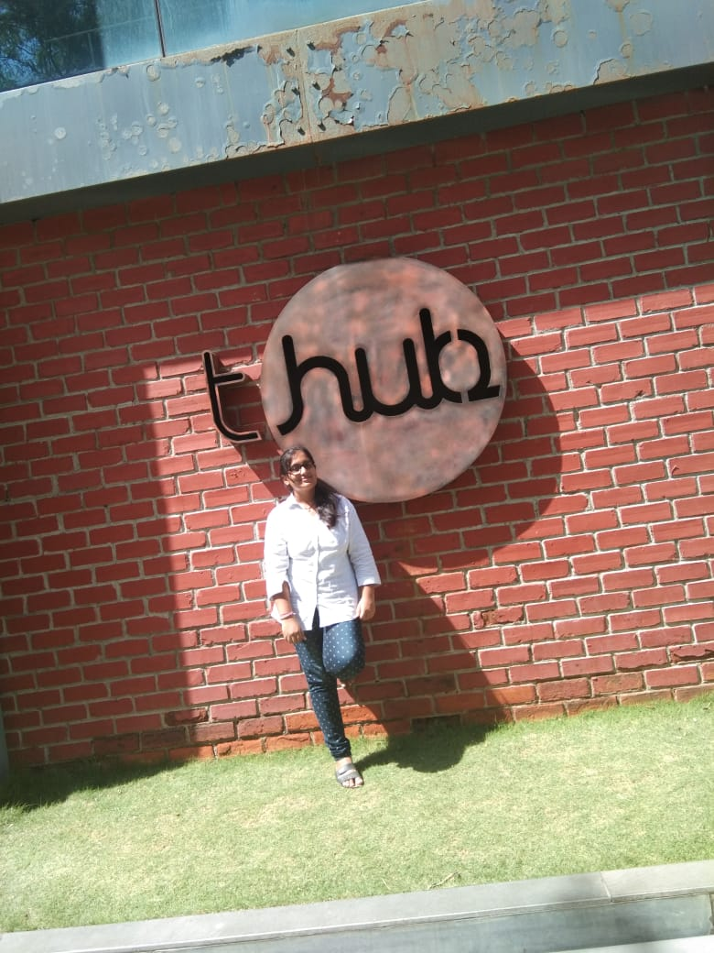
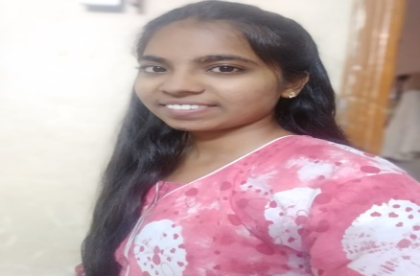
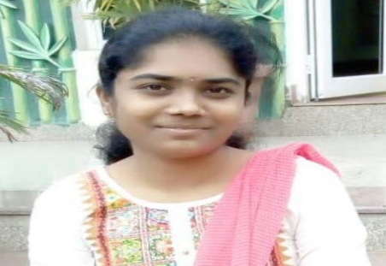
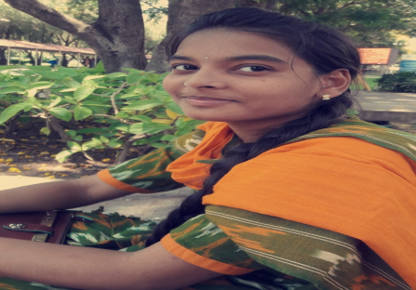
Meet the Team
M. Srija
ECE 3rd year Android App Development
D. Sai Sowmya
ECE 3rd year Device Design
K. Bhavya Sri
ECE 2nd year Study of Eye Disease & Market Research
D. Neelima
ECE 2nd year Design & Hardware

Slide 18
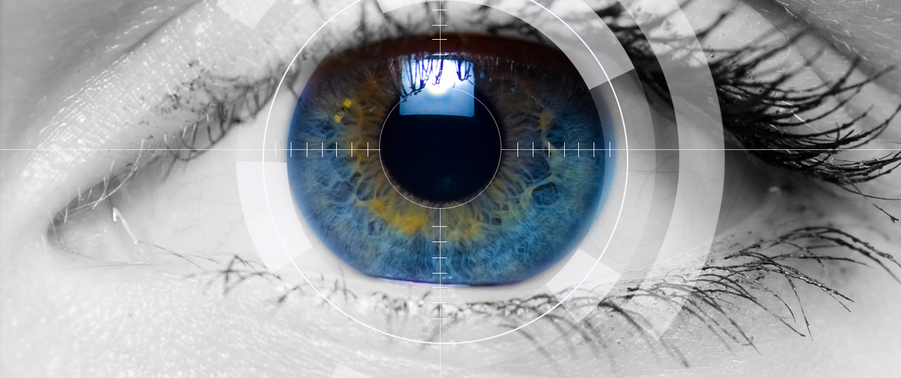
We’d Love your Feedback!
Thank you

